Slide 1
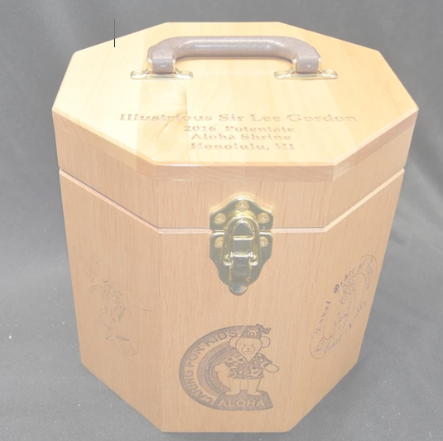
Orak Shrine Fez Case Raffle
$20/ticket, only 50 tickets will be sold
Custom Wooden Fez Case with personalization
(3 lines on lid, 2 designs on sides)
Winner receives a gift certificate for the fez case.
This is a custom, made-to-order Fez Case and the winner will work with the craftsman for the final customization.
Expected delivery is six to eight weeks, but may be longer based on the degree of customization work the winner chooses.
Proceeds benefit Orak Shrine and are Not Tax-Deductible
Drawing held when 50 tickets are sold.
License #:
003265
Tickets Available from Any Divan Member or at the Orak Office during Business Hours

